Slide 1
National Income and its Components - GNP, NNP, GDP, NDP
Ravi Kiran

Slide 2
National income
National income is used interchangeably with national output and national expenditure.
In common parlance, national income means the total value of goods and services produced annually in a country.
The total amount of income accruing to a country from economic activities in a year’s time is known as national income.
It includes payments made to all resources in the form of wages, interest, rent and profits.

Slide 3
Concepts pertaining to National Income
There are a number of concepts pertaining to national income and methods of measurement relating to them.
Gross Domestic Product (GDP)
GDP Deflator
Gross National Product (GNP)

Slide 4
Gross Domestic Product
GDP is the total value of goods and services produced within the country during a year.
This is calculated at market prices and is known as GDP at market prices.
Dernberg defines GDP at market price as “the market value of the output of final goods and services produced in the domestic territory of a country during an accounting year.”

Slide 5
There are two ways that GDP can increase:
An increase in the PRICES of goods and services.
An increase in the QUANTITY of goods and services.
We need a method to calculate GDP that addresses rising prices

Slide 6
Our Simple Economy
Suppose an economy produces three goods or services, A, B, & C.
Data for the past three years is given.

Slide 7
GDP
 |  | 2016 |  | 2017 |  | 2018
 | Quantity | Price | Quantity | Price | Quantity | Price
Product A | 90 | 50 | 100 | 60 | 100 | 65
Product B | 75 | 2 | 100 | 2 | 120 | 2.25
Product C | 50 | 30 | 50 | 25 | 65 | 25

Slide 8
Nominal GDP
 | Nominal GDP
 |  | 2016 |  |  | 2017 |  |  | 2018
 | Quantity | Price | Nominal GDP | Quantity | Price | Nominal GDP | Quantity | Price | Nominal GDP
Product A | 90 | 50 | 4500 | 100 | 60 | 6000 | 100 | 65 | 6500
Product B | 75 | 2 | 150 | 100 | 2 | 200 | 120 | 2.25 | 270
Product C | 50 | 30 | 1500 | 50 | 25 | 1250 | 65 | 25 | 1625
 |  |  | 6150 |  |  | 7450 |  |  | 8395
Nominal GDP (The value of final goods and services evaluated at current-year prices) for each year.

Slide 9
Real GDP
 |  | Real GDP
 |  | 2016 |  |  | 2017 |  |  | 2018
 | Quantity | Price | Nominal GDP | Quantity | Price | Real GDP | Quantity | Price | Real GDP
Product A | 90 | 50 | 4500 | 100 | 60 | 5000 | 100 | 65 | 5000
Product B | 75 | 2 | 150 | 100 | 2 | 200 | 120 | 2.25 | 240
Product C | 50 | 30 | 1500 | 50 | 25 | 1500 | 65 | 25 | 1950
 |  |  | 6150 |  |  | 6700 |  |  | 7190
(The value of final goods and services evaluated at base-year prices) for each year
For our example assume 2016 is the base year. This means that all values are in what we call “2016 Rs”, or “Constant Rs”.

Slide 10
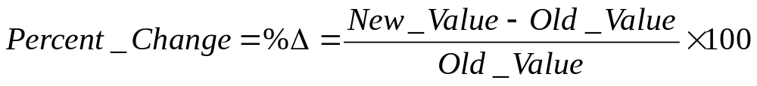
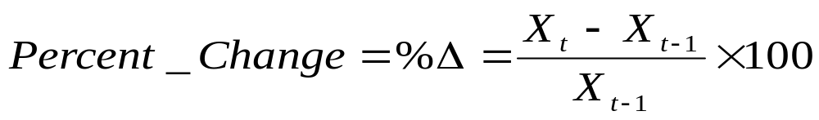
The General Formula for Calculating a Growth Rate

Slide 11
Growth Rate of real GDP
 | Growth Rate of real GDP
2016 | 6150 | 0.089 | 8.94
2017 | 6700 | 0.073 | 7.31
2018 | 7190

Slide 12
The Price Level
We can use our calculations of Nominal GDP and Real GDP to calculate the Price Level (A measure of the average prices of goods and services in the economy.)

Slide 13
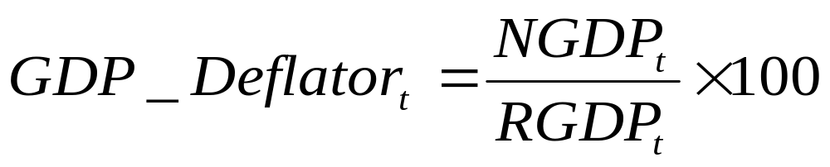
The GDP Deflator
One example of a measure of the average price level is the GDP deflator.
NGDP: Nominal Gross Domestic Product
RGDP: Real Gross Domestic Product

Slide 14
GDP Deflator
 | Nominal GDP | Real GDP | GDP Deflator
2016 | 6150 | 6150 | 100
2017 | 7450 | 6700 | 111.194
2018 | 8395 | 7190 | 116.759
Note: The GDP Deflator is always equal to 100 in the base-year.

Slide 15
Year | Nominal GDP | Real GDP | GDP Deflator
2016 | 6150 | 6150 | 100
2017 | 7450 | 6700
2018 | 8395 | 7190
2019 | 9100 | 7450
2020 | 9800 | 8100

Slide 16
The Inflation Rate
We can use the growth rate formula from previous to calculate the Inflation Rate (the Inflation Rate is The percentage increase in the price level from one year to the next.)
[(GDP Def.2017 – GDP Def.2016)/GDP Def.2016] x 100

Slide 17
Inflation Rate
 | Nominal GDP | Real GDP | GDP Deflator |  | Inflation rate
2016 | 6150 | 6150 | 100
2017 | 7450 | 6700 | 111.194 | 0.1119 | 11.19
2018 | 8395 | 7190 | 116.759 | 0.05005 | 5.005
[(GDP Def.2017 – GDP Def.2016)/GDP Def.2016] x 100

Slide 18
What does GDP indicate?
Money value of all the final goods and services produced in a country during an accounting year
A larger gross domestic product, there are more goods and services that can be used to satisfy unlimited wants and needs.

Slide 19
Gross National Product
Gross National Product (GNP): combined value of all the final goods and services produced in a country during an accounting year, including net factor income from foreign countries.
GNP = GDP + Net factor income from abroad (difference between income earned in foreign countries by residents of a country and income earned by foreign nationals domestically).

Slide 20
GNP: Gross National Product
Definition: market value of all final goods and services produced and sold in a given year
GNP or Y= C + I + G + X-M
  Y= national income
  C= consumption
  I=investment
  G= government expenditures
  X= exports
  M= imports

Slide 21
GNP measures
Quantity of all goods and services
Summed up Economic activity
Often its assumed that total welfare and economic welfare move together
GNP does not measure
Welfare
Distribution of wealth
Human development or capacity for development
Uneconomic growth
Unpaid work
Natural resources

Slide 22
GDP Vs GNP
GDP is the sum value of all goods and services produced within a country.
GNP is the sum value of all goods and services produced by permanent residents of a country regardless of their location.
GDP of a particular country, production by foreigners within that country is counted and production by nationals outside of that country is not counted.
For GNP, production by foreigners within a particular country is not counted and production by nationals outside of that country is counted.

Slide 23
GNP, NNP , NI
GNP (Gross National Product): combined value of all the final goods and services produced in a country during an accounting year, including net factor income from foreign countries.
NNP (Net National Product): = GNP – depreciation (consumption of fixed capital)
National Income: = NNP – indirect business taxes + business subsidies

Slide 24
payments for goods and services
Circular flow diagram. The diagram above represents the transactions between firms and households in a simple economy.
In the upper loop, the arrow emanating from firms to households represents the sale by firms of goods and services to households. On the other hand, the arrow from households to firms represents the payments.
In the lower loop, the arrow originating from the households to the firms shows that firms hire labor and capital from households in order to produce goods and services. The arrow emanating from the firms indicates their payments for the use of the factors of production.
goods and services
FIRMS
HOUSEHOLDS
Factor services
Wages, interest, rent, profit
Factor payments

Slide 25
Revenue (=GDP)
Spending (=GDP)
MARKETS FOR GOODS AND SERVICES
Goods and services sold
Goods and services bought
FIRMS
HOUSEHOLDS
Inputs for Production
Land, labor and capital
MARKETS FOR FACTORS OF PRODUCTION
Wages, rent, interest and profit (=GDP)
Income (=GDP)
Flow of goods & services
Flow of money
THE CIRCULAR FLOW DIAGRAM

Slide 26
With government and foreign agents
Need to account for :
  Government purchases of goods and services.
  Government payments for factor services (wages, rent, interest).
  Transfer payments between different agents.
  Firms and households pay taxes to government.
  Taxes paid on income, property, goods and services.
  Transactions with the foreign sector.

Slide 27
Transfer payments
Transfer payments – are transactions wherein one party is not obliged to deliver a good or service in return for the payment.
Examples: retirement benefits, unemployment benefits, scholarships, and donations.

Slide 28
Transactions with foreign sector
Includes sales of goods and services, assets, and transfers
Exports-sales of domestically produced goods to other countries
Imports-goods bought from other countries

Slide 29
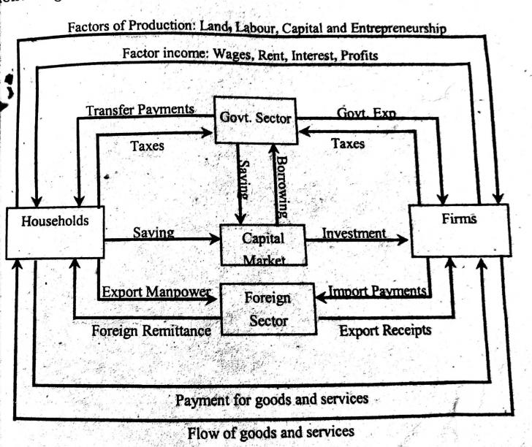

Slide 30
Circular flow model in four sector economy
Foreign sector has an important role in the economy.
When the domestic business firms export goods and services to the foreign markets, injections are made into the circular flow model.
On the other hand, when the domestic households, firms or the government imports something from the foreign sector, leakage occurs in the circular flow model.

Slide 31
Household Sector
Receipts
The household sector receives factor income in the form of rent, wages, interest, and profit from the business sector. It also receives transfer payments from the government sector.
Payments
The income of the household sector flows into the business sector, government sector and capital markets in the form of consumption expenditure, taxes and savings respectively.

Slide 32
Business Sector
Receipts
The principle receipts of the business sector constitute of income from the sale of goods and services, income from exports, subsidies from government sector, and borrowings from the capital market.
Payments
Factor payments, import payments, and savings constitute the principle payments from business sector to the household sector, government sector, foreign sector and the capital market.

Slide 33
Government Sector
Receipts
The major source of income for the government sector include the taxes paid by household and business sector. Besides this, it also receives interests and dividends for the investments made.
Payments
The government sectors make payments to different sectors in the form of transfer payments, subsidies, grants, etc. It pays to the business sector in return for the goods purchased, makes transfer payments like pension funds, scholarships, etc. to the household sector..

Slide 34
Government Sector
If the government receipts are greater than the expenses, the surplus goes to capital market.
In case of cash deficit, the government borrows from the capital market to maintain a balance in the economy

Slide 35
Foreign Sector
Receipts
The foreign sector receives income from the business sector in return for the goods and services imported by the latter.
Payments
Foreign sectors need to make payment to the business sector from where imports have been made.
If exports exceed imports, the economy has surplus balance of payment. In case exports exceed imports, the economy faces a deficit balance of payment.

Slide 36
3 Approaches for measuring GNP
Expenditure Approach (upper loop) – measures GDP as the sum of expenditures on final goods and services.
Income Approach (lower loop) – measures GDP as the sum of incomes of factors of production (wages, rent, interest and profit.
Value-added Approach – measures GDP as the sum of value added at each stage of production (from initial to final stage)

Slide 37
Expenditure Approach
Uses the upper loop of the circular flow diagram.
Example: Suppose the economy has only one product, namely, rice.
Good | Price per unit | Q sold | Expenditure
Rice | 20 | 1000 | 20,000
 |  | GDP | 20,000

Slide 38
Income Approach
Uses the lower loop of the circular flow diagram: sum of payments to the various factors of production.
Suppose that in the production of rice the sales and expenses are as follows:
Sales |  | 20,000
Expenses:
Wages | 8000
Rent | 4000
Interest | 2000
Total | 14,000
Profit | 6,000
GDP=Sum of Payments to factors | 20,000 | 20,000

Slide 39
Value Added Approach
Suppose that rice is the only final product of an economy:
It goes through several (3) stages of production.
Stage of Production | Value of intermediate good | Value of Sales | Value-added
Farmer - Palay |  | 12,000 | 12,000
Rice Miller -Milled Rice | 12,000 | 15,000 | 3,000
Retailers - Rice | 15,000 | 20,000 | 5,000
GDP= Total Value Added |  |  | 20,000

Slide 40
Notes of the 3 approaches
The expenditure approach, income approach, and the value-added approach all come up with the same estimate of the GDP. They are equivalent approaches.
In the income approach, profit is also considered a payment to the entrepreneur. So the incomes are (1) wages, (2) rent, (3) interest, and (4) profit. Profit adjusts to make the sum equal to the final value of the good.
In the value added approach, only the value added in each stage of production are included. If we add the value of intermediate product with the value of the final product, we commit the sin of “double-counting.”
At each stage of production, the value-added is equal to wages, interest, rent, and profit. Therefore the value of the final product is likewise the same of all payments to the factors of production.

Slide 41
GDP Measures Market Activity, Not Welfare
GDP does not measure happiness, nor does it measure economic welfare.
Welfare is a complicated idea, very difficult to measure.

